Slide 1

Learn
Part 5
Regular Expression

Slide 2

Regular Expressions are "formulas" used to describe a string of text. Regular expressions (regex, regexes) are at the heart of dialplan, and are used in many other parts of FreeSWITCH configuration. You can describe patterns of extensions, DIDs, users, callers, callees, gateways, etc with regular expressions in FreeSWITCH.

Slide 3
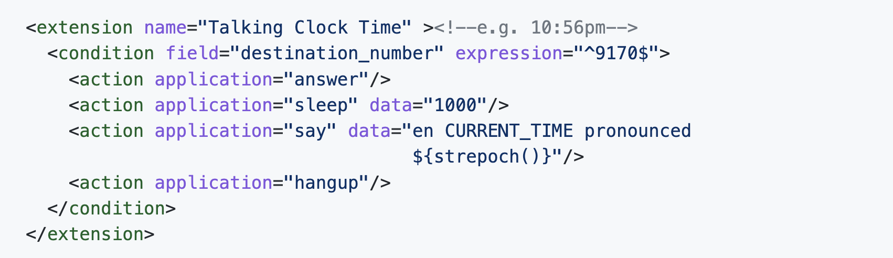
In dialplan regexes are used to define the "expression" criterion of the "condition" tag.

Slide 4
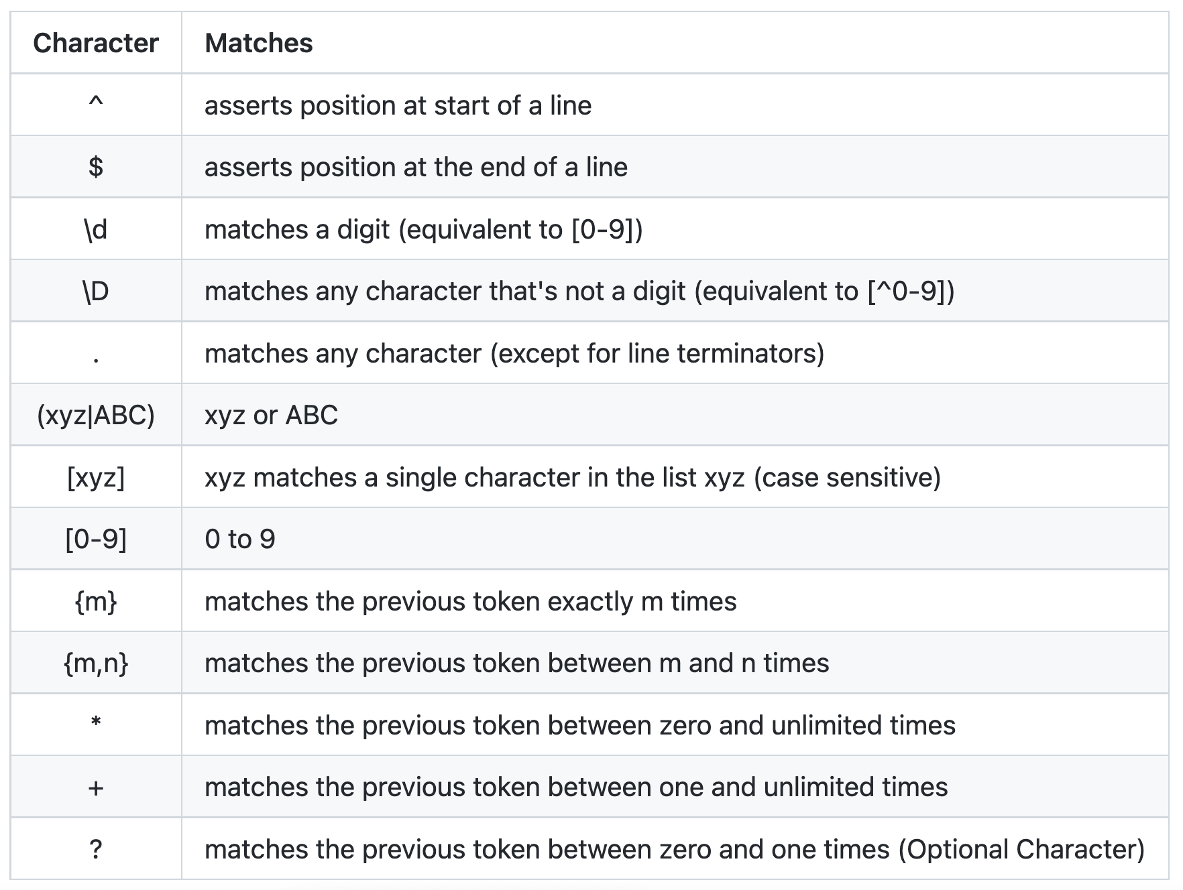

Slide 5
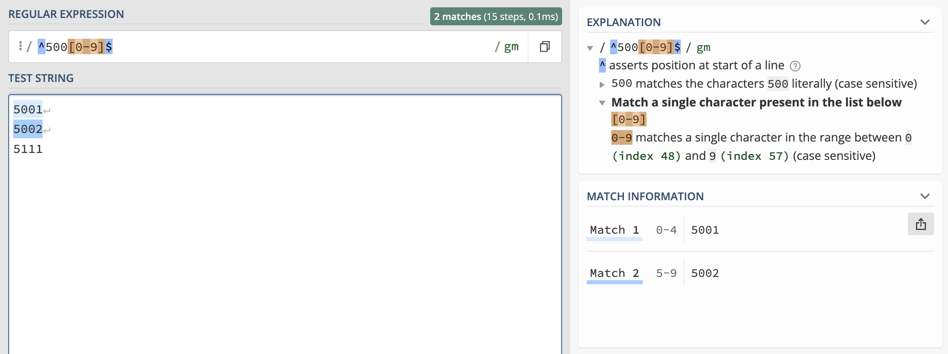
https://regex101.com/

Slide 6
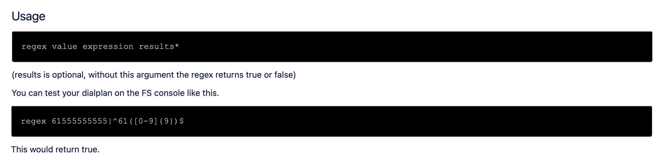
The regex FreeSWITCH console command needs at least two arguments: the data to test and the pattern to match against. The arguments are separated by a | (pipe) character. The regex command will return true if the data and the pattern match, otherwise it will return false.

Slide 7
You can check regular expression online here:
https://regex101.com/

Slide 8
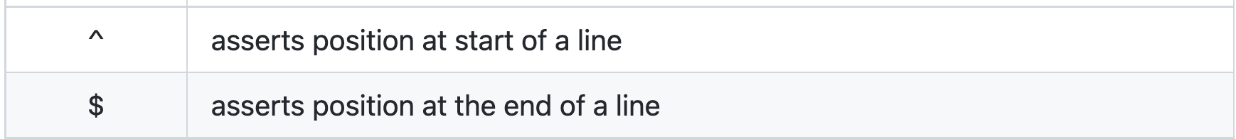

Slide 9
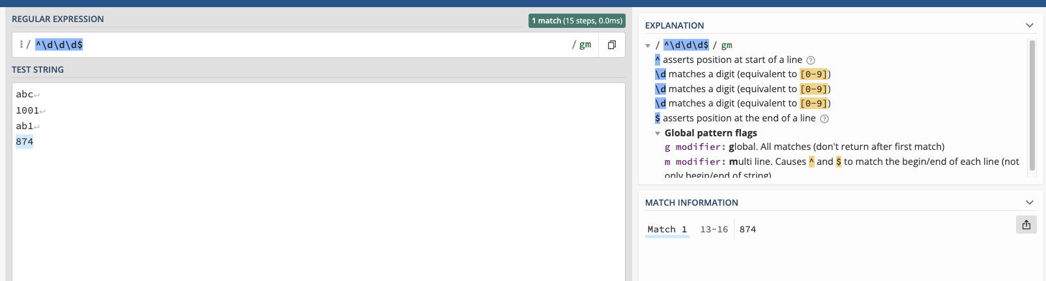

Slide 10
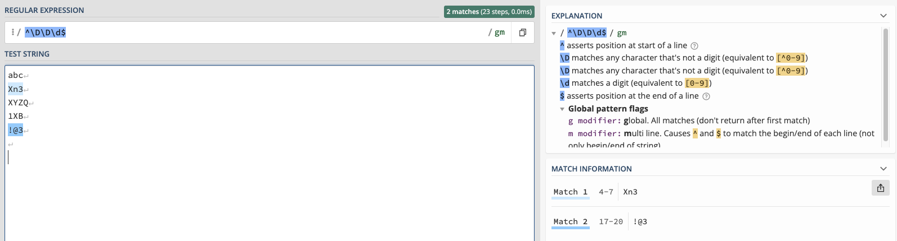

Slide 11
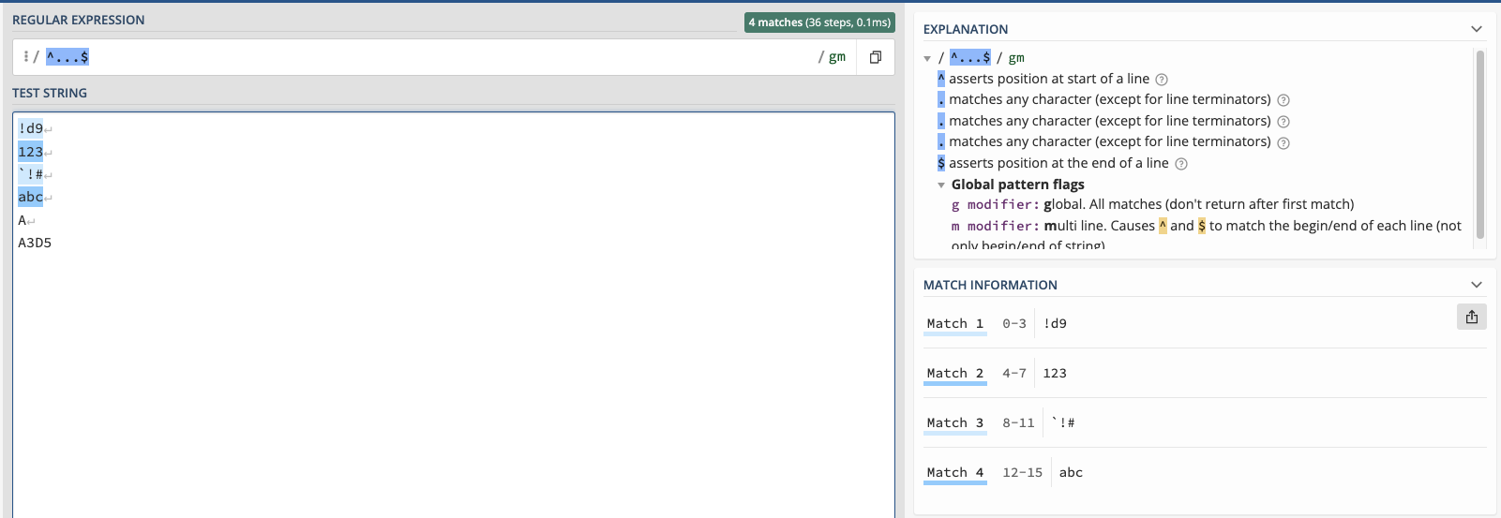

Slide 12
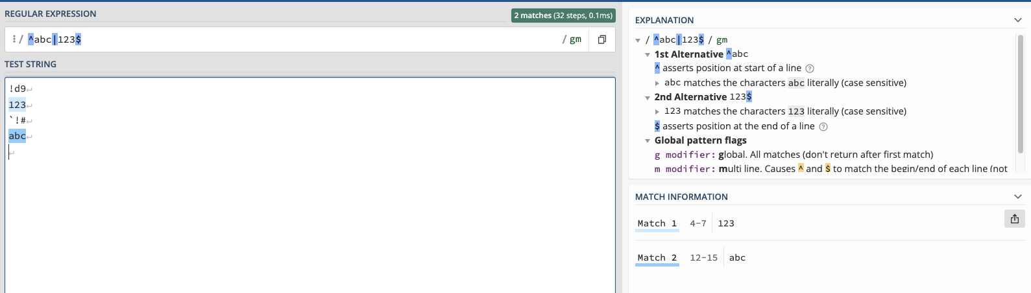

Slide 13
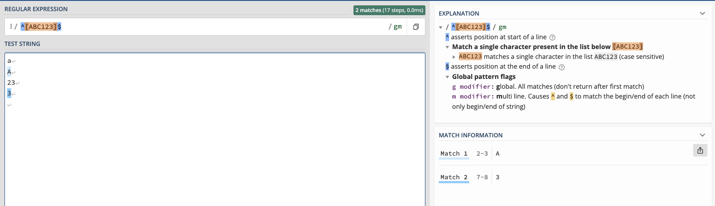

Slide 15
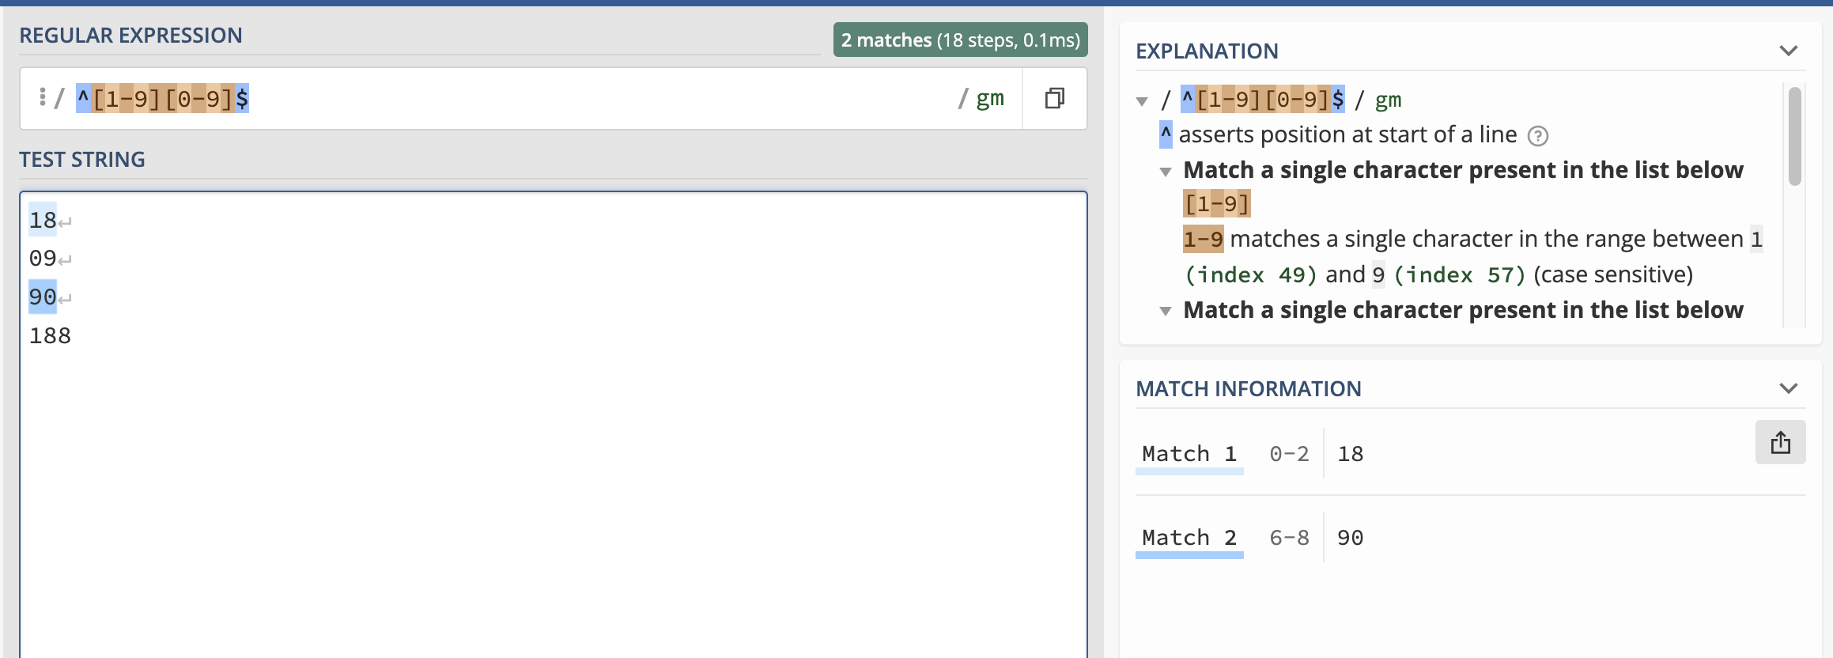

Slide 16
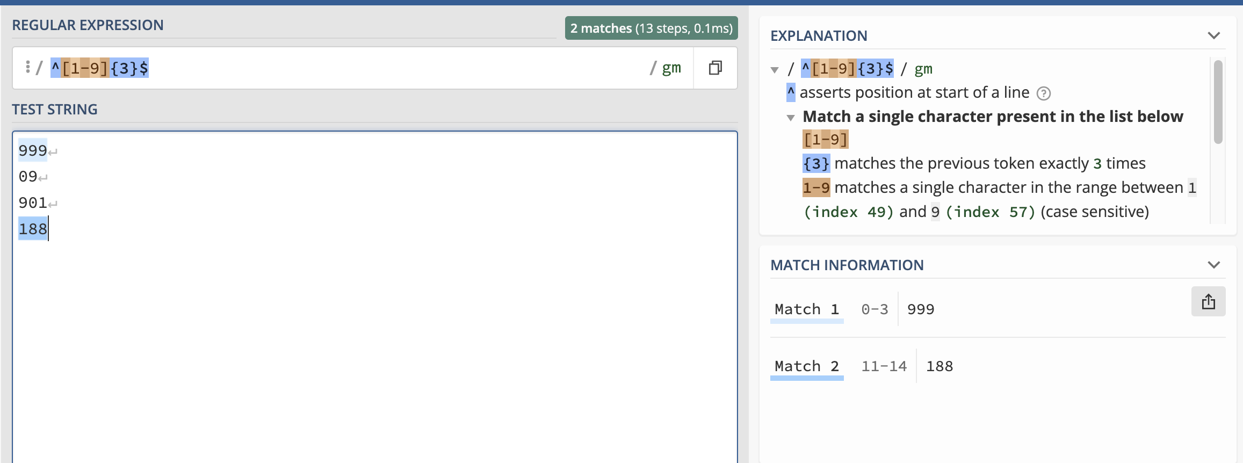

Slide 17
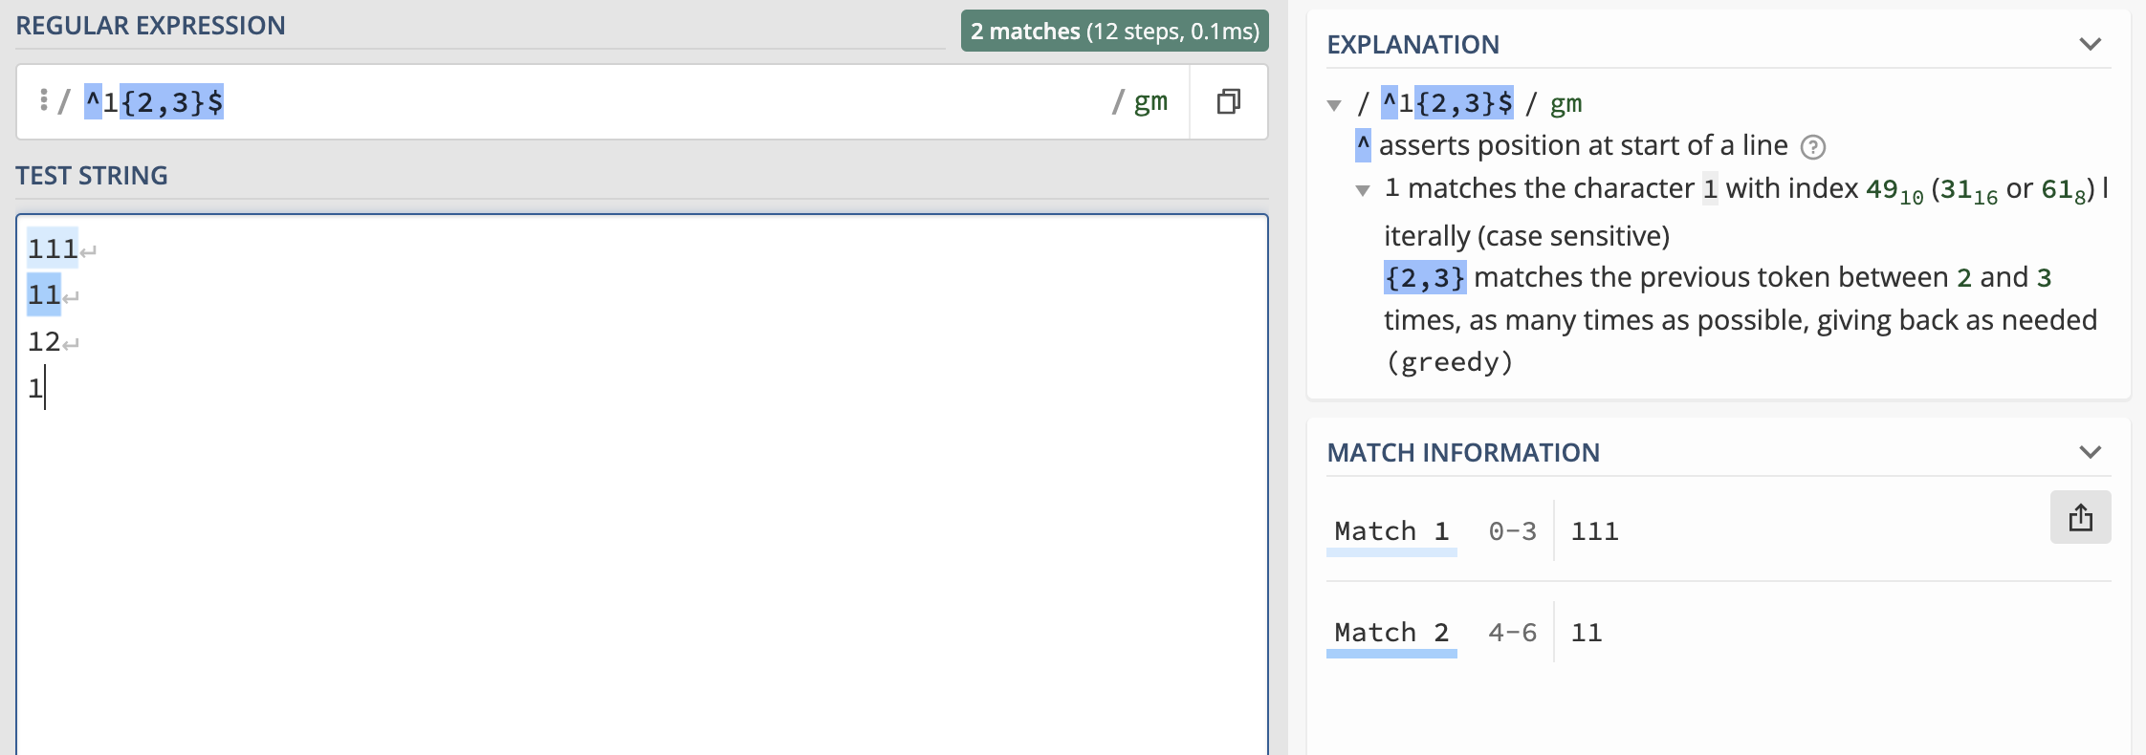

Slide 18
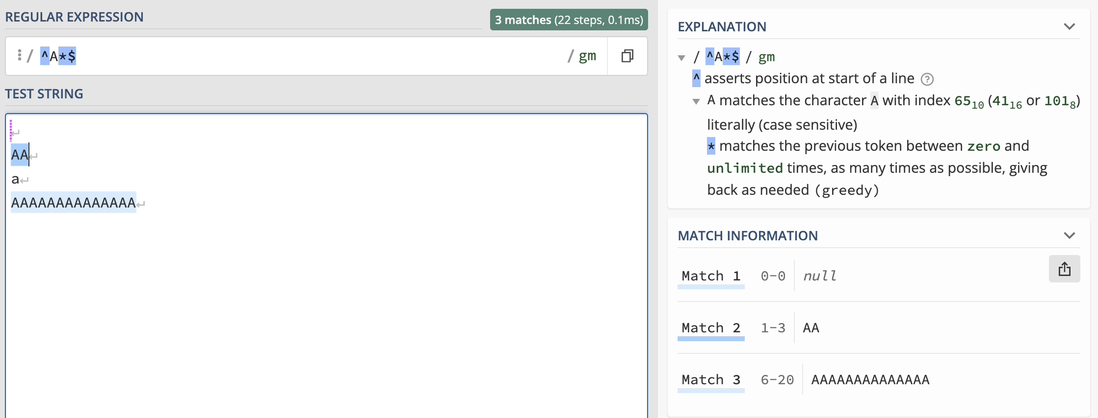

Slide 19
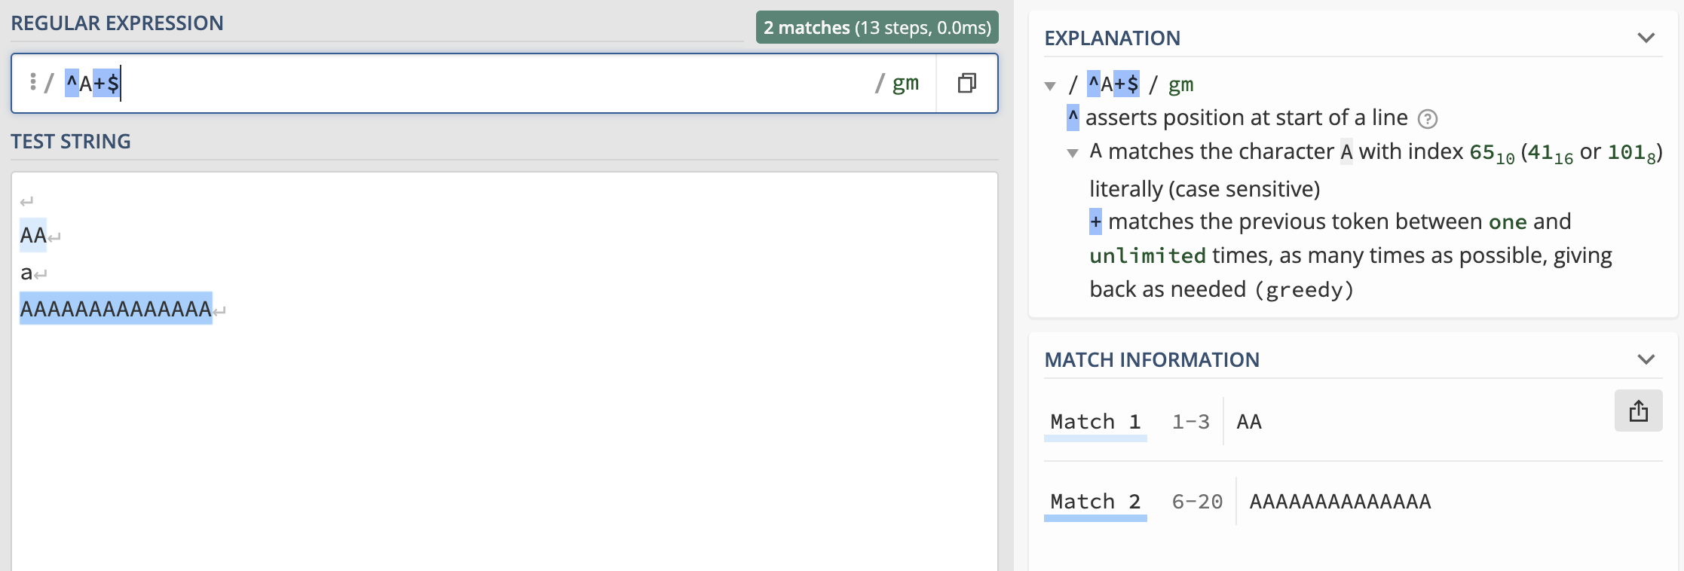

Slide 20
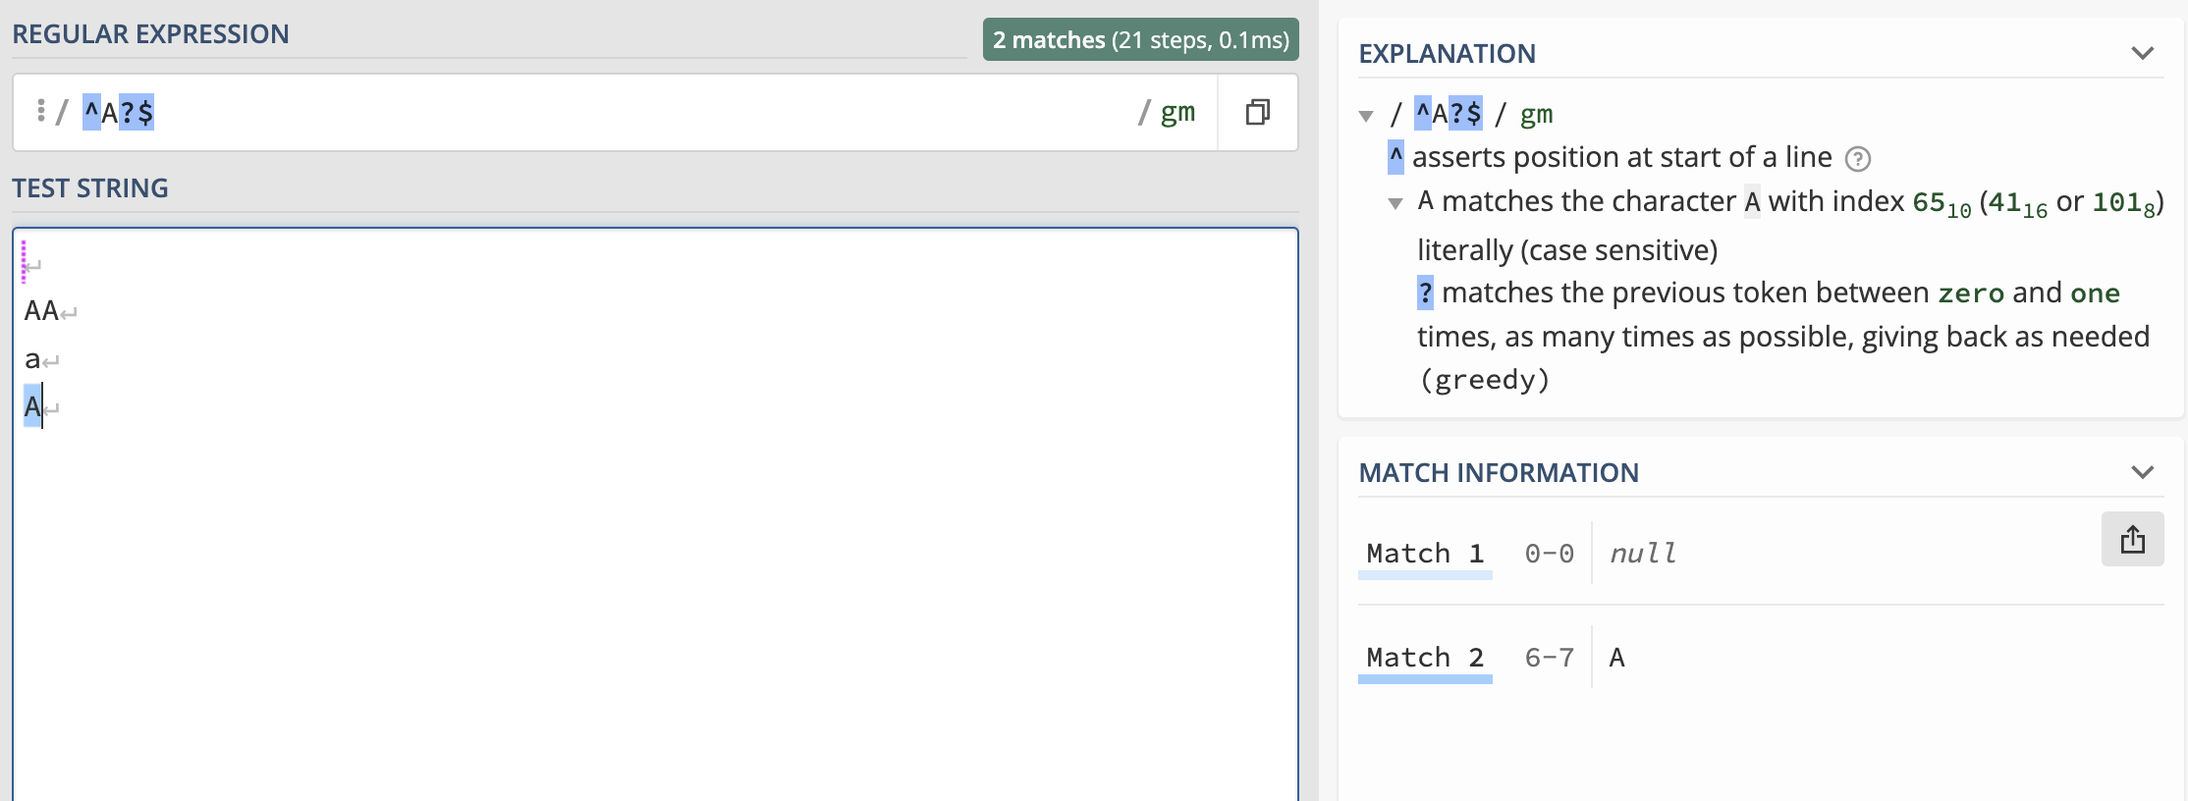

Slide 21
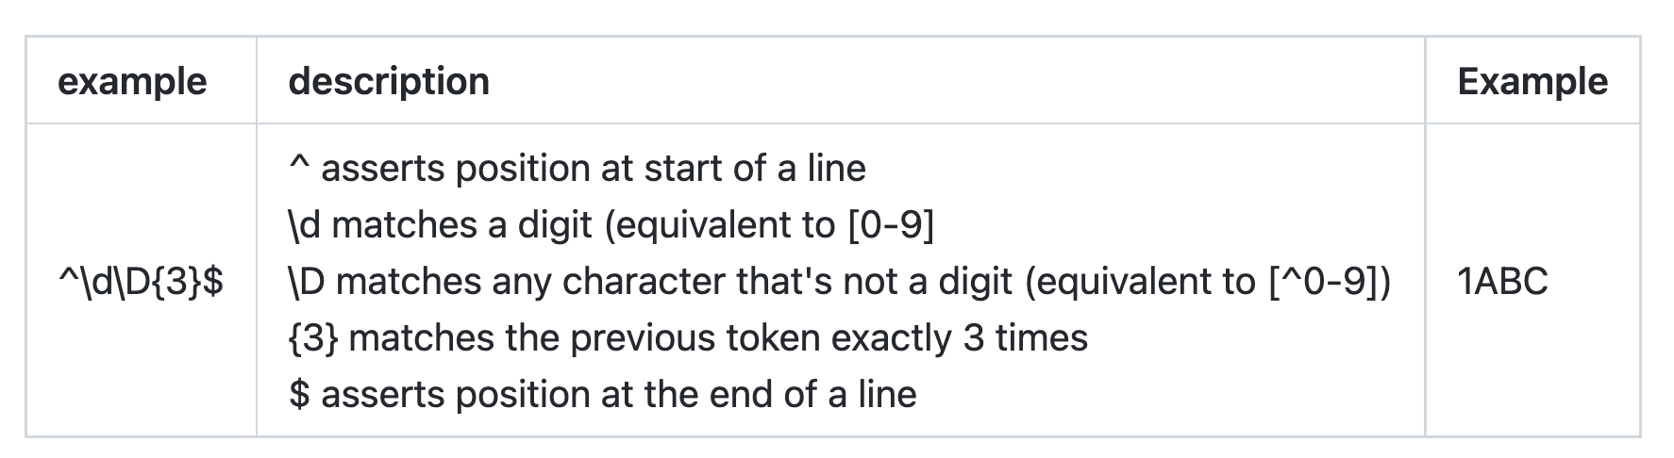

Slide 22
